Slide 1
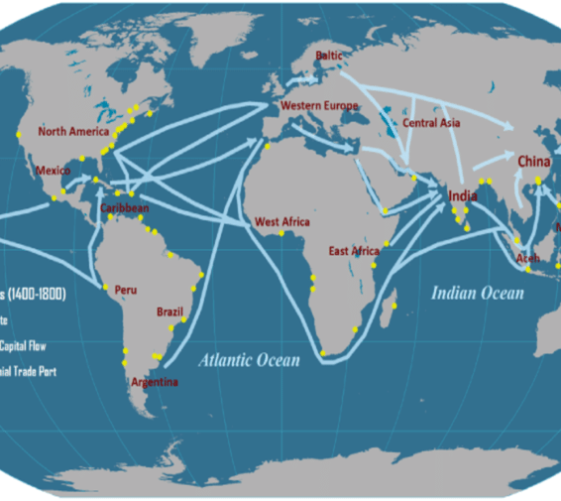
Transforming Trade Finance: A Hyperledger Fabric Solution
By: Nikhil Gupta and Deepanshi Bansal
Notes:
Good morning/afternoon/evening everyone. Today, I will be presenting our report on a novel solution to address the inefficiencies in traditional trade finance processes: a secure and transparent trade finance platform built on Hyperledger Fabric, a blockchain technology platform. By the end of this presentation, you will understand the challenges of traditional trade finance, how our Hyperledger Fabric solution works, and the potential impact it can have on international trade.

Slide 2

The Problem: Traditional Trade Finance Inefficiencies
Manual, paper-based processes
Delays and errors
High costs
Security risks
Lack of transparency
Notes:
International trade is the backbone of the global economy. However, it is often hindered by inefficiencies in traditional trade finance processes. These processes are manual, paper-based, and prone to errors. This leads to delays in transactions, which can disrupt supply chains and cause financial losses. Traditional trade finance is also expensive, with high fees associated with document processing and intermediaries. Additionally, paper-based documents are vulnerable to fraud and forgery. Finally, the lack of transparency in traditional trade finance makes it difficult for all parties involved to track the progress of a transaction.

Slide 3

The Impact of the Problem
Delays in trade transactions
Increased costs for businesses
Risk of fraud
Hinders global economic growth
Notes:
The inefficiencies in traditional trade finance have a significant negative impact on the global economy. Delays in trade transactions can disrupt supply chains and lead to lost sales opportunities. These inefficiencies also increase costs for businesses, who must pay for document processing, intermediaries, and insurance against fraud. The risk of fraud is a major concern in traditional trade finance, with businesses losing billions of dollars each year. Ultimately, these problems hinder global economic growth by making it more difficult and expensive to conduct international trade.

Slide 4
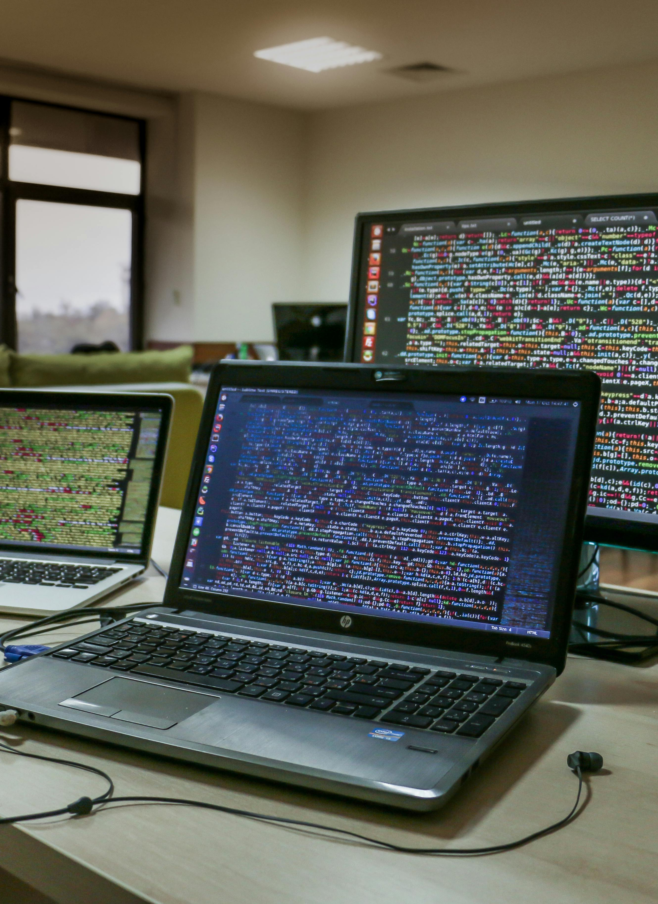
Our Solution: Hyperledger Fabric Trade Finance Platform
Built on Hyperledger Fabric blockchain platform
Automates document exchange
Uses smart contracts for secure transactions
Improves transparency
Reduces costs
Notes:
Our proposed solution to these challenges is a secure and transparent trade finance platform built on Hyperledger Fabric, an open-source blockchain platform designed for building secure and scalable business networks. Our platform automates document exchange, eliminating the need for manual processing and reducing the risk of errors. It leverages smart contracts, self-executing code stored on the blockchain, to ensure that transactions are completed only when all pre-defined conditions are met. This enhances security and reduces the risk of fraud. Additionally, our platform provides all participants with a shared ledger, providing real-time visibility into the status of a transaction and fostering trust among all stakeholders. By automating processes, improving security, and increasing transparency, the Hyperledger Fabric trade finance platform can significantly reduce the costs associated with traditional trade finance.

Slide 5
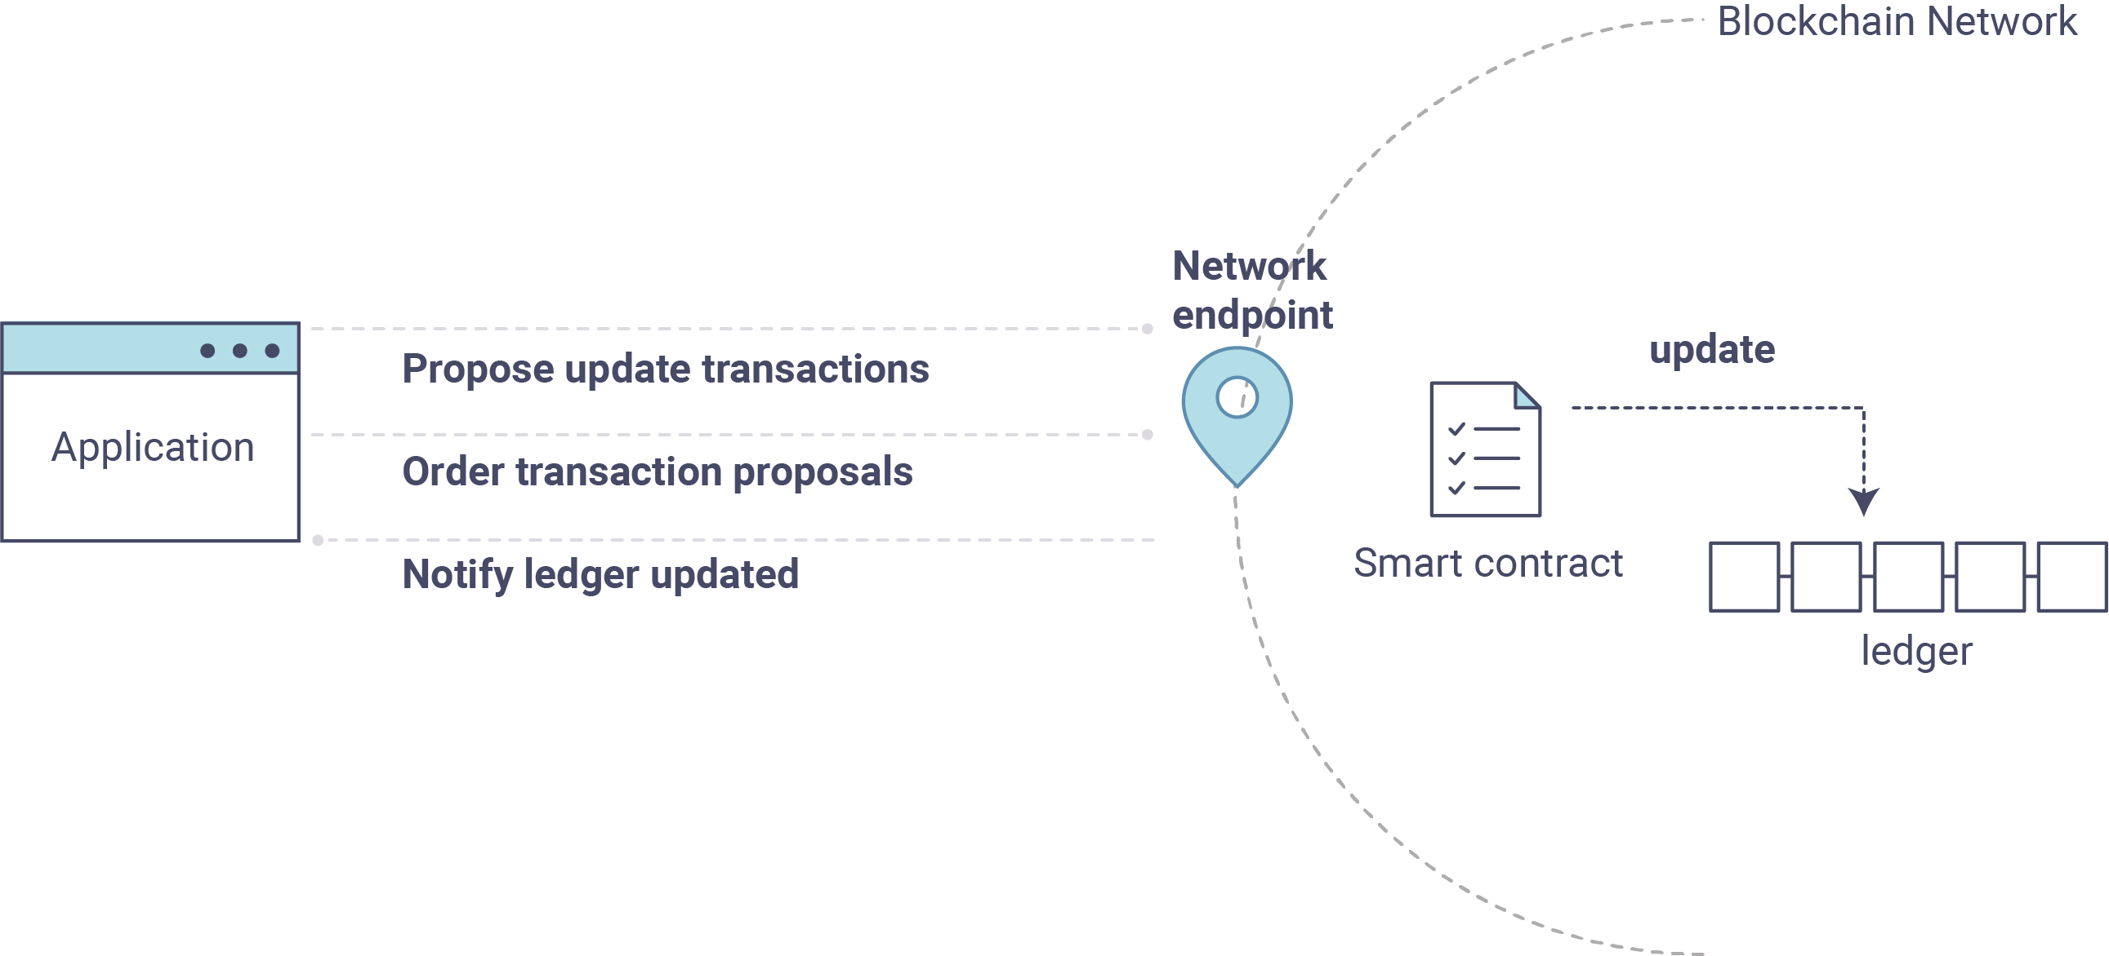
How the Hyperledger Fabric Trade Finance Platform Works
Trade initiation & document upload
Smart contract execution
Payment release
Notes:
Let's take a closer look at how our Hyperledger Fabric trade finance platform works. First, a trade transaction is initiated on the platform, with details of the goods, payment terms, and required documents being uploaded. These documents can include invoices, bills of lading, and certificates of origin. Once the documents are uploaded, smart contracts automatically verify and approve them based on pre-defined conditions. These conditions may include the verification of the buyer's creditworthiness or the receipt of confirmation that the goods have been shipped. Once all conditions are met, the smart contract automatically triggers the release of payment from the buyer's bank to the seller's bank. This eliminates the need for manual approvals and significantly reduces transaction processing times.

Slide 6

Benefits of the Hyperledger Fabric Trade Finance Platform
Increased Efficiency
Enhanced Security
Improved Transparency
Reduced Costs
Notes:
The Hyperledger Fabric trade finance platform offers a number of significant benefits over traditional trade finance processes. First, it automates many manual tasks, which significantly increases efficiency and reduces processing times. Second, the platform leverages blockchain technology to provide a high level of security for trade transactions. All documents and data are stored on a tamper-proof ledger, making them virtually impossible to counterfeit or alter. Additionally, smart contracts ensure that transactions are completed only when all pre-defined conditions are met. Third, the platform provides all participants with a shared ledger, giving them real-time visibility into the status of a transaction. This transparency fosters trust and accountability among all stakeholders. Finally, by automating processes, reducing errors, and eliminating the need for intermediaries, the Hyperledger Fabric trade finance platform can significantly reduce the costs associated with traditional trade finance.

Slide 7

Unique Selling Proposition (USP) of our Solution
Enhanced Security: Permissioned blockchain & cryptography
Scalability & Flexibility: Hyperledger Fabric architecture
Open-Source Platform: Fosters collaboration and innovation
User-friendly Platform
Notes:
Our Hyperledger Fabric trade finance platform offers several unique advantages over other trade finance solutions. First, our platform utilizes a permissioned blockchain architecture, meaning only authorized participants can join the network. This controlled environment ensures compliance with regulations and maintains the privacy of sensitive trade data. Additionally, our platform leverages robust cryptography to guarantee the immutability and tamper-proof nature of trade documents. Second, Hyperledger Fabric offers a scalable architecture that can accommodate a growing number of users and transaction volume. This ensures that our platform can meet the needs of the global trade finance market. Third, by building on an open-source platform, we foster collaboration and innovation within the trade finance community. This allows for continuous improvement of the platform to address evolving needs. Finally, our platform is designed to be user-friendly, with an intuitive interface that can be easily adopted by all stakeholders involved in trade finance.

Slide 8

Competition & Barrier to Entry
Existing Trade Finance Platforms
Alternative Trade Finance Solutions
Complexity of Hyperledger Fabric
Network Effects
Regulatory Uncertainty
Notes:
While our Hyperledger Fabric trade finance platform offers a compelling solution, there are existing players and challenges to consider. There are several established trade finance platforms already in operation. These platforms may offer some level of automation and document management, but they may lack the security and efficiency benefits of blockchain technology. Additionally, alternative trade finance solutions, such as supply chain finance, can compete with traditional trade finance products. However, these solutions might not offer the same level of security and transparency as a blockchain-based platform. Beyond competition, there are also barriers to entry that need to be considered. Setting up and managing a Hyperledger Fabric network requires technical expertise. This can be a barrier for some businesses and financial institutions that lack the necessary in-house skills or resources. Additionally, building a critical mass of users across banks, businesses, and other stakeholders can be challenging initially. The regulatory environment surrounding blockchain technology in trade finance is still evolving. Uncertainties regarding regulatory compliance can create hesitation for some institutions to adopt the technology.

Slide 9

Our Competitive Advantage
Superior Security: Blockchain technology
Enhanced Transparency: Shared ledger
Focus on User Experience
Consortium Approach
Industry-Specific Customization
Notes:
Despite these challenges, our Hyperledger Fabric solution offers several competitive advantages. First, our platform leverages the inherent security features of blockchain technology to provide a more secure and tamper-proof environment compared to traditional trade finance platforms. All documents and data are stored on a distributed ledger, making them highly resistant to fraud and cyberattacks. Second, our platform provides all participants with a shared ledger, fostering greater transparency and trust in the trade finance process. Everyone involved in a transaction can see the status of the transaction in real time. This transparency helps to reduce errors and disputes. Third, we are committed to developing a user-friendly platform that is easy to use for all stakeholders involved in trade finance. Finally, We believe that collaboration is key to the success of our Hyperledger Fabric trade finance platform. We plan to build a consortium of leading banks, businesses, and regulatory bodies as early adopters. This consortium will help to develop the platform, promote its adoption, and ensure that it meets the needs of the trade finance industry. In addition to collaboration, we also plan to offer industry-specific customization. Our platform can be tailored to address the specific needs of different trade finance sectors, such as commodities trade or cross-border financing. This will make our platform more attractive to a wider range of users.

Slide 10
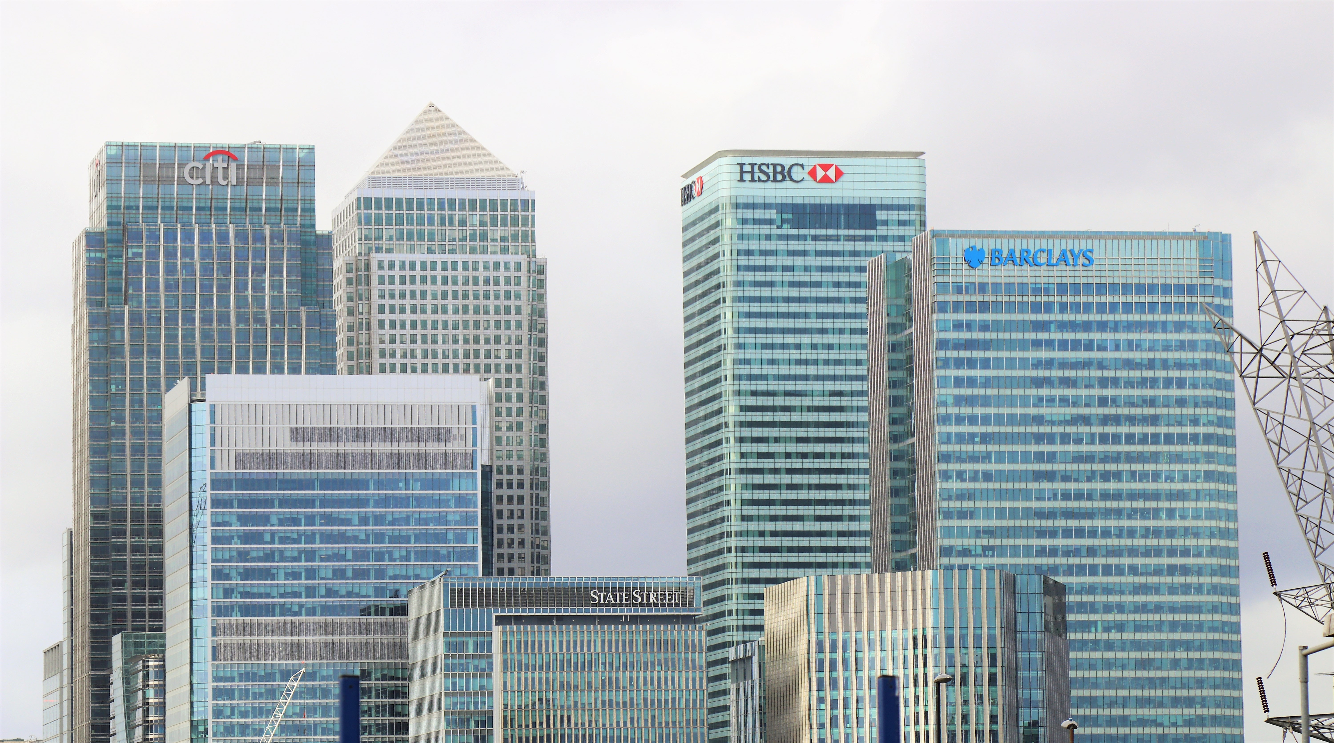
Target Market
Banks and Financial Institutions
Businesses (Importers & Exporters)
Logistics Providers
Regulatory Bodies
Notes:
The Hyperledger Fabric trade finance platform targets a broad range of participants within the international trade ecosystem. First, banks and financial institutions can leverage our platform to offer more efficient and secure trade finance products to their clients. This can help them to attract new business and increase profitability. Second, businesses involved in international trade can benefit from faster transaction processing times, reduced costs, and enhanced security. Our platform can help them to improve their cash flow and manage their trade finance risks more effectively. Third, logistics providers can utilize our platform to facilitate document exchange and verification related to shipments. This can improve efficiency and transparency in the trade finance process. Finally, regulatory bodies can use our platform to monitor trade finance activities and ensure adherence to regulations. This can help to reduce the risk of fraud and financial crime in trade finance.

Slide 11

Reaching Customers
Industry Events & Conferences
Partnerships & Collaborations
Digital Marketing Strategy
Educational Outreach
Targeted Advertising
Focus on User Experience
Notes:
Reaching our target market will require a multi-pronged approach. First, we will participate in industry events and conferences to connect with potential customers. This will allow us to showcase our platform and educate potential users about the benefits of blockchain technology in trade finance. Second, we will build partnerships and collaborations with established players in the trade finance ecosystem. This will help us to reach a wider audience and leverage the expertise of our partners. Third, we will develop a digital marketing strategy to reach potential customers online. This will include creating informative content, such as blog posts and white papers, and utilizing social media to promote our platform. Fourth, we will conduct educational outreach programs to help potential customers understand the benefits of our platform. Fifth, we will consider targeted advertising to reach specific demographics and business profiles. Finally, we will focus on providing a user-friendly platform with clear onboarding materials and tutorials. This will make it easy for new users to get started with our platform.

Slide 12
Conclusion
Inefficiencies in traditional trade finance
Our solution: Hyperledger Fabric platform
Potential impact: Revolutionize international trade
Notes:
In conclusion, traditional trade finance processes are plagued by inefficiencies that lead to delays, high costs, and security risks. Our proposed solution, a secure and transparent trade finance platform built on Hyperledger Fabric, has the potential to revolutionize international trade. By automating processes, enhancing security, and improving transparency, our platform can streamline trade finance transactions and benefit all stakeholders involved in international trade. We believe that our platform has the potential to make international trade faster, cheaper, and safer for everyone.

Slide 13
Thank You

